Slide 1
PIP4004 - INTERNSHIP Review-4 Presentation Dispatcher Process Monitoring Dashboard
Student Details
Name | VATHSALA B S
Roll No | 20211CAI0203
Section | 8CAI/CST-03
Batch No. | CSE_CAI_CAP_41
Under the Supervision of,
Dr. Mohammedi Akheela Khanum
Assistant Professor
School of Computer Science and Engineering
Presidency University
Name of the Program: B. Tech
Name of the HoD: Dr. Zafar Ali Khan
Name of the Program Internship Coordinator: Dr. Sivaramakrishnan
Name of the School Project Coordinators: Dr. Sampath A K / Dr. Abdul Khadar A / Mr. Md Ziaur Rahman

Slide 2
Content
About Company or Organization
Working domain or the technology
About your team and reporting Manager
Challenges Faced in Internship
Objectives of the work
Literature Review
Proposed System
Problem Statement
System Requirements
Advantages of Proposed System/Work
Internship Roadmap
Github Link

Slide 3
About Company or Organization
Company Overview
Name: Inteva Products, LLC
Founded: 2008
Headquarters: Troy, Michigan, USA
Global Presence: Nearly 30 locations across North America, South America, Europe, and Asia
Employees: Approximately 8,000
Industry: Automotive
Website: www.intevaproducts.com

Slide 4
Product Portfolio
Interior Systems:
Instrument panels
Consoles
Door trim
Cockpits
Headliners
Closure Systems:
Door latches
Compartment latches
Strikers
Electronic actuators
Motors & Electronics:
Window lift motors
Seat motors
Actuators
Electronic control units

Slide 5
Clients and Market Presence
Client Base:
Over 50 customers in more than 40 countries
Major global automakers and regional Original Equipment Manufacturers (OEMs)
Industries Served:
Automotive
Commercial vehicle
Defense
Marine
Consumer and industrial sectors

Slide 6
Working domain or the technology
Analysis of Problem Statement
A dispatcher process monitoring dashboard is designed to track and manage dispatcher processes in real-time. It ensures that system operations run smoothly, identifies failures, and provides actionable insights for maintaining efficiency.

Slide 7
Key Challenges & Issues
Lack of Real-time Monitoring: Without an efficient dashboard, tracking dispatcher processes and their statuses in real-time becomes difficult.
Error Detection and Logging: Identifying system failures or process crashes manually is inefficient.
Scalability: As the system grows, monitoring a large number of dispatcher processes becomes complex.
User Interface & Experience: The dashboard needs to be user-friendly, with clear data visualization for quick decision-making.
Security & Access Control: Unauthorized access to process logs and monitoring tools can lead to security risks.
Integration with Other Systems: The dashboard may need to fetch data from external sources via APIs.

Slide 8
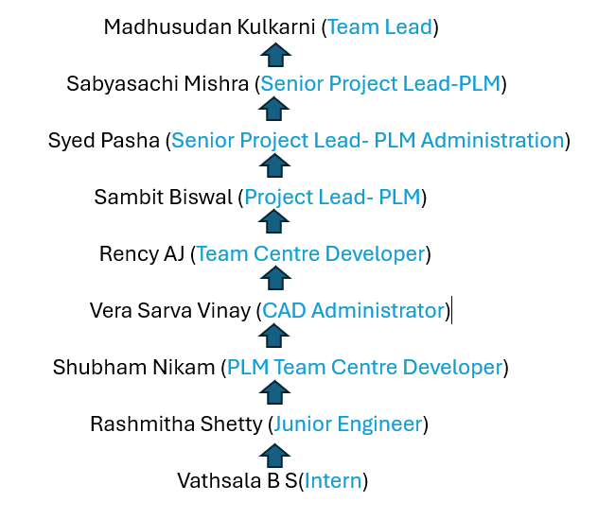
About the team and reporting Manager

Slide 9
Challenges Faced in Internship
Challenges in Searching for an Internship
1. Finding the Right Opportunities:
Competition: High competition for popular roles.
Limited Availability: Some fields have fewer internship opportunities.
Application Process: Time-consuming with tailored resumes and cover letters for each application.
2. Cracking the Interview:
Technical Tests: Coding assessments can be intimidating.
Behavioral Questions: You must demonstrate teamwork, problem-solving, and conflict resolution.
Nervousness: The pressure to perform can affect confidence and performance.
3. Adjusting to the Team:
Work Culture: Adapting to different workplace environments and dynamics.
Team Communication: Learning to collaborate with varying communication styles.
Technical Environment: Quickly adapting to new tools and technologies.

Slide 10
Objectives of the Work
Real-time Process Monitoring: Display active, pending, and failed dispatcher processes.
Error Logging & Reporting: Provide logs and insights for debugging issues efficiently.
Scalable & Responsive UI: Ensure the dashboard works across various devices with smooth navigation.
Web Socket Integration: Allow data fetching from the API link and ensure smooth communication between frontend and backend.

Slide 11
Literature Review
1) Real-Time Monitoring & Process Efficiency
Enhances task execution, error detection, and resource tracking (Smith et al., 2020).
Used in manufacturing, logistics, and software development.
2) Data Processing & Visualization
Technologies: HTML, CSS, JavaScript for UI (Kumar, 2022).
Real-time updates: Web Sockets & event-driven architectures (Brown & Johnson, 2021).
Data representation: Dynamic tables (Chen et al., 2023).
3) Integration with PLM & Teamcenter
Web sockets enable seamless data exchange and improve backend communication.
(Wang & Lee, 2022).

Slide 12
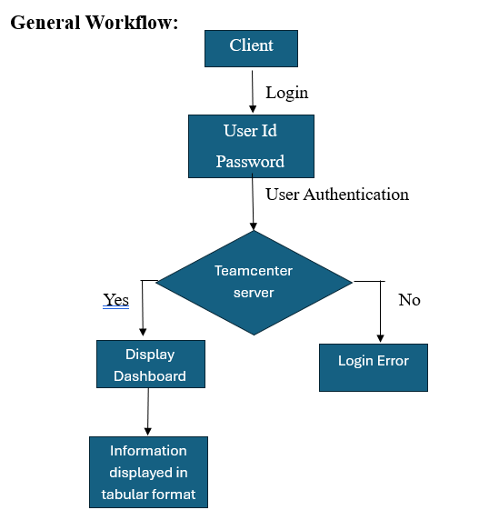
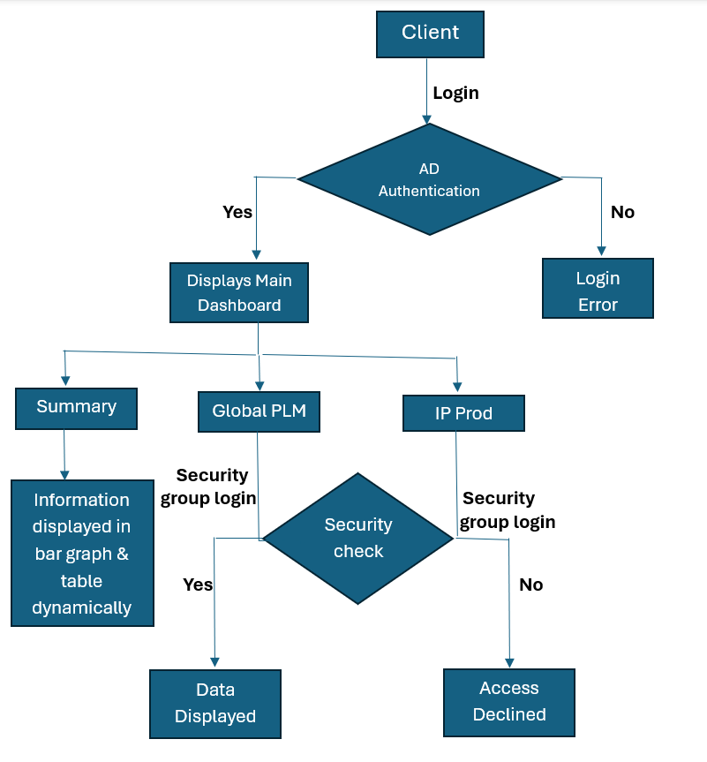
Proposed System

Slide 13
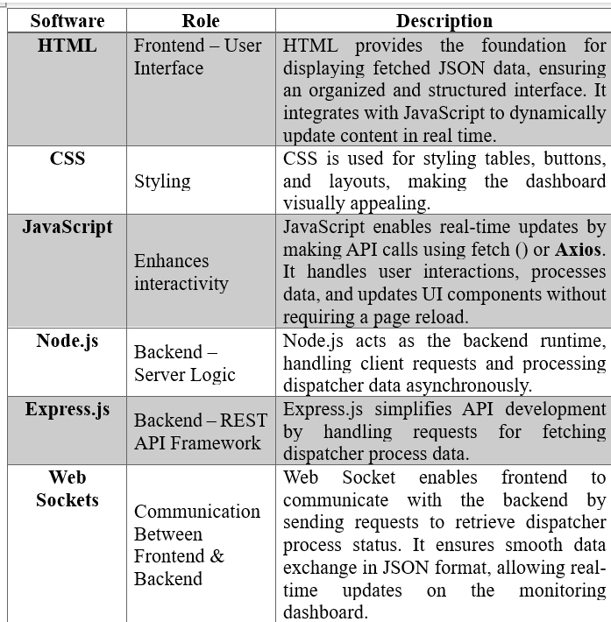
System Requirements

Slide 14
Advantages of Proposed System/Work
Real-Time Monitoring
Improved Efficiency
User-Friendly Interface
Dynamic Data Updates
Optimized Performance
Scalability
Enhanced Security
Error Handling & Logging

Slide 15
Internship Road Map
Note: Write in the below table what u will be achieving in each review
Review 0
Evaluate early performance integration and understanding of tasks.
Review 1
Ensure the dashboard fetches and displays real-time data accurately. Verify that all dispatcher processes and status are correctly shown.
Review 2
Implemented 50% of the project successfully.
Review 3
Successfully implemented the project as per the requirements.

Slide 16
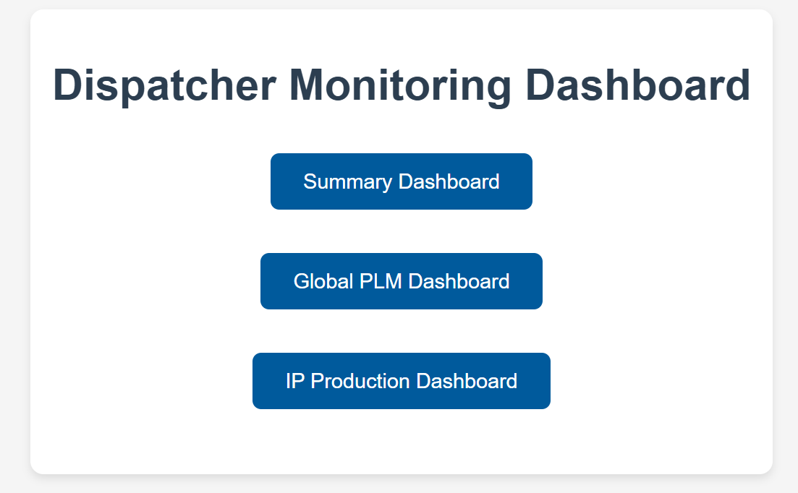
Screenshots

Slide 17
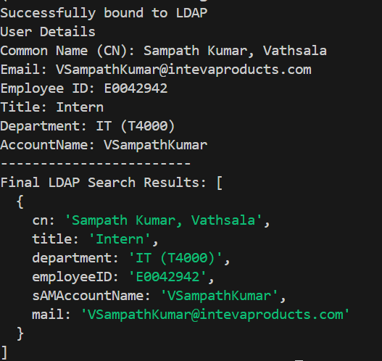
Screenshots

Slide 18
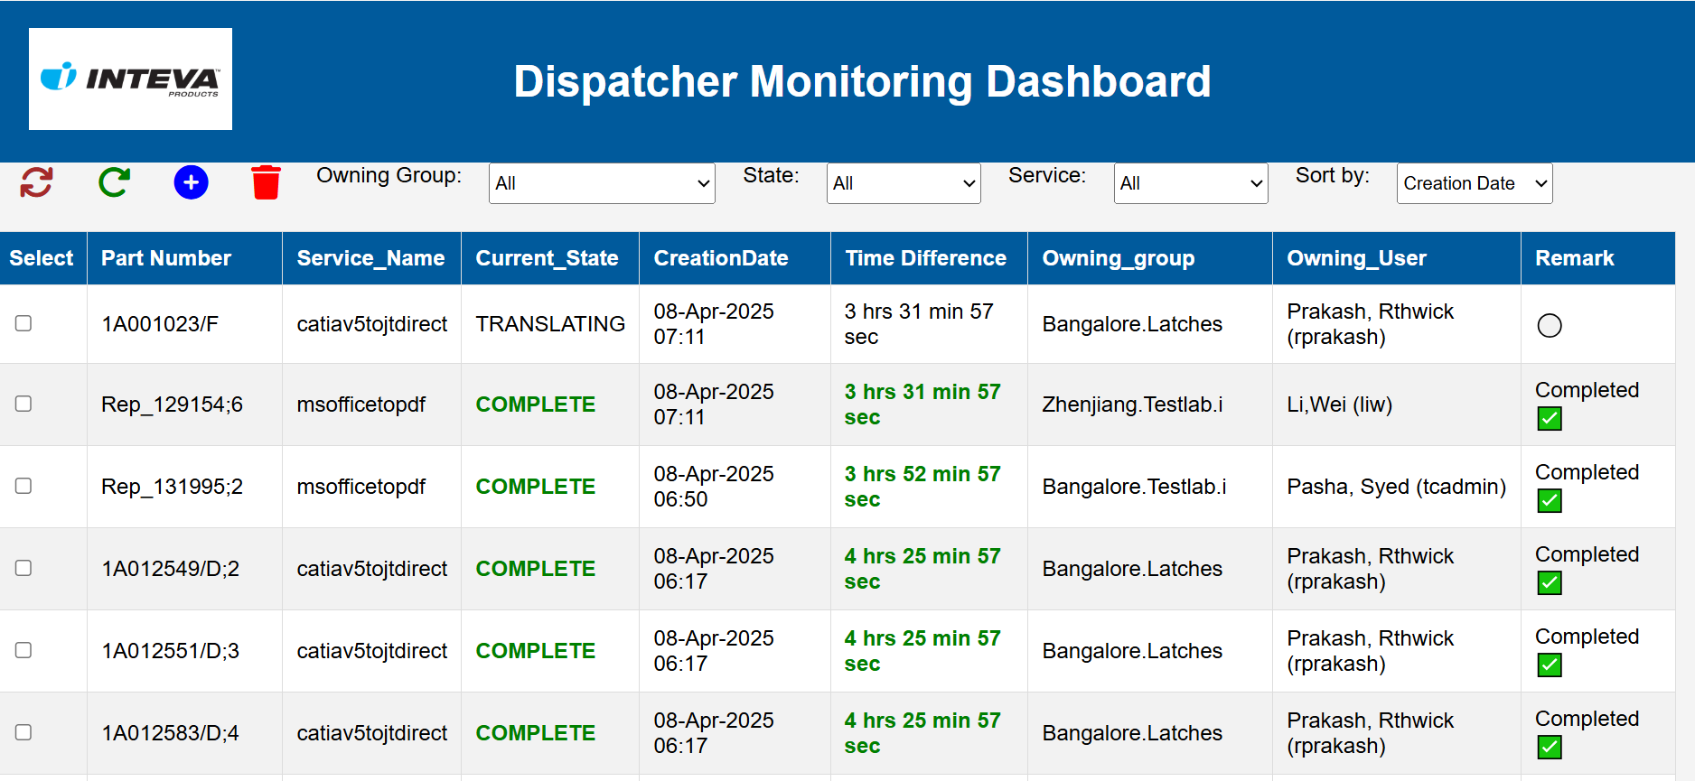
Screenshots

Slide 19
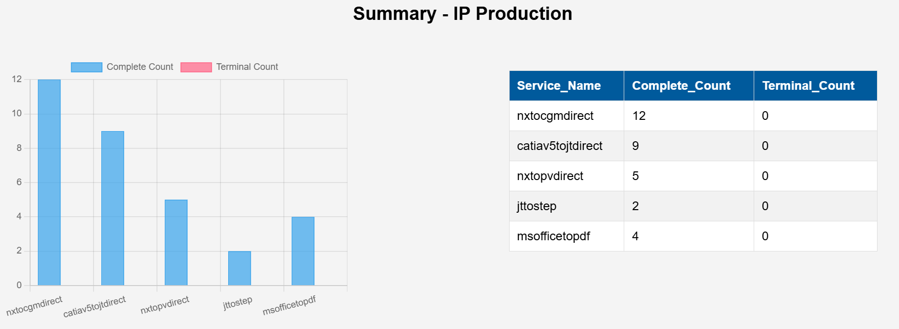
Screenshots

Slide 20
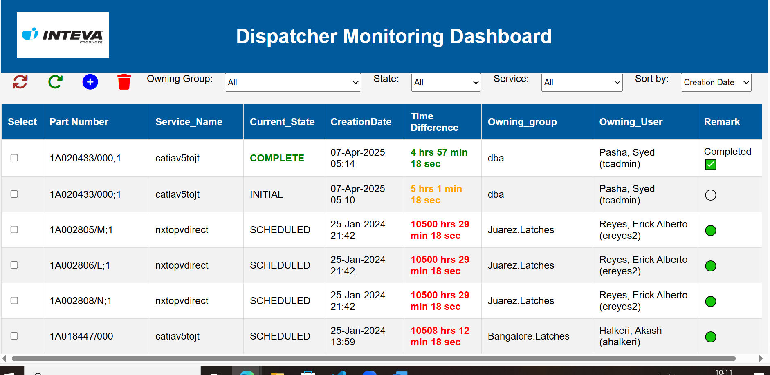
Screenshots

Slide 21
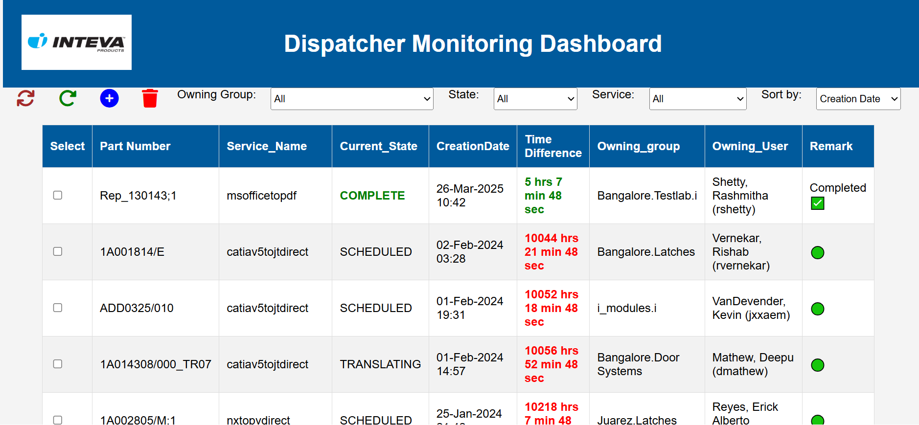
Screenshots

Slide 22
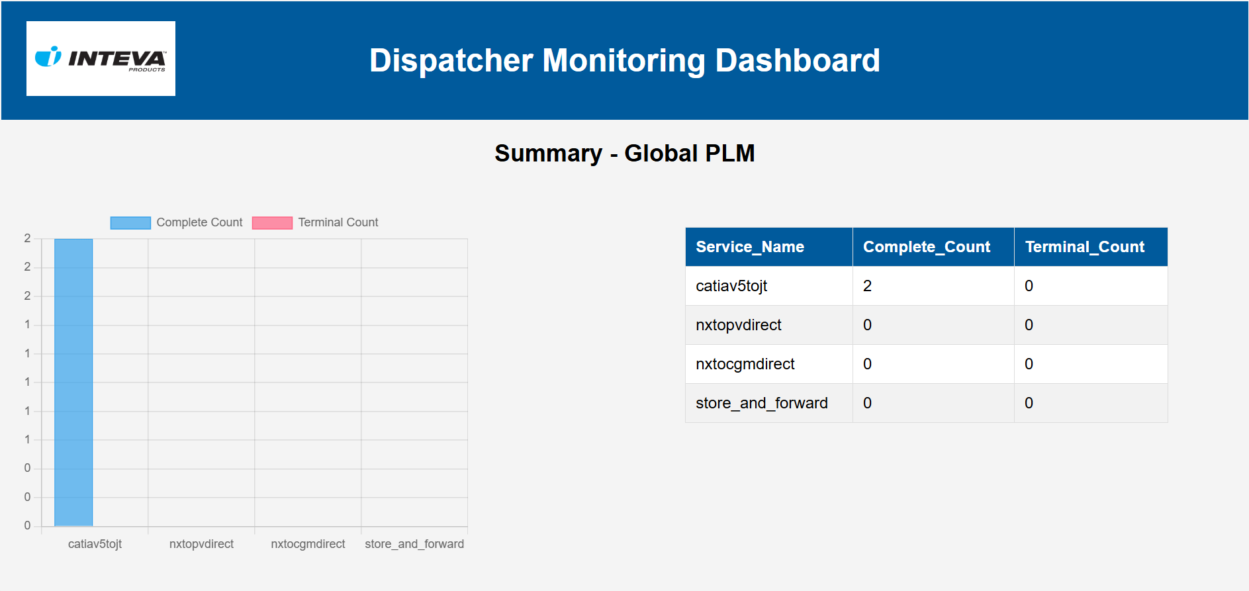
Screenshots

Slide 23
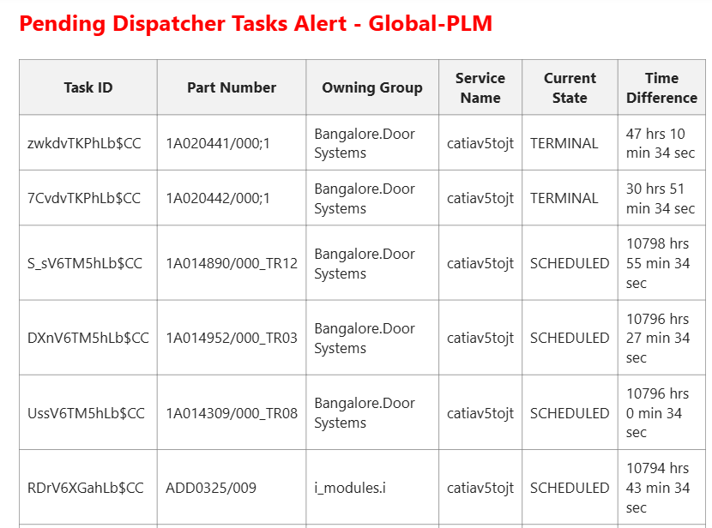
Screenshots

Slide 24
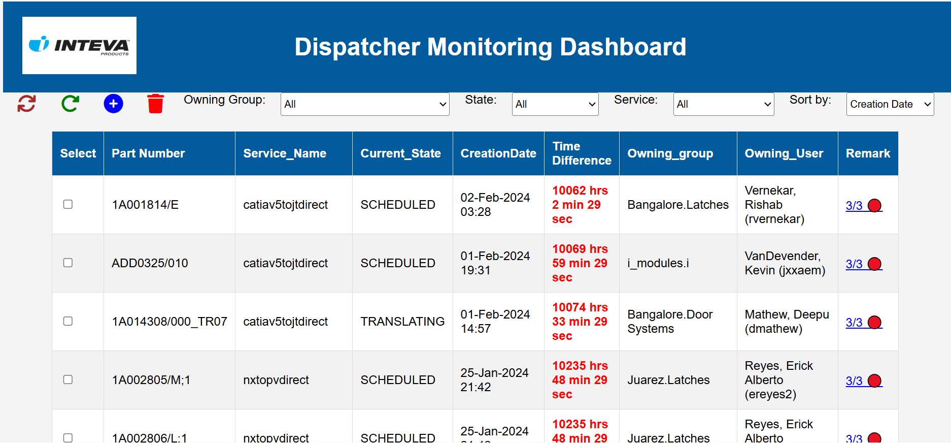
Screenshots

Slide 25
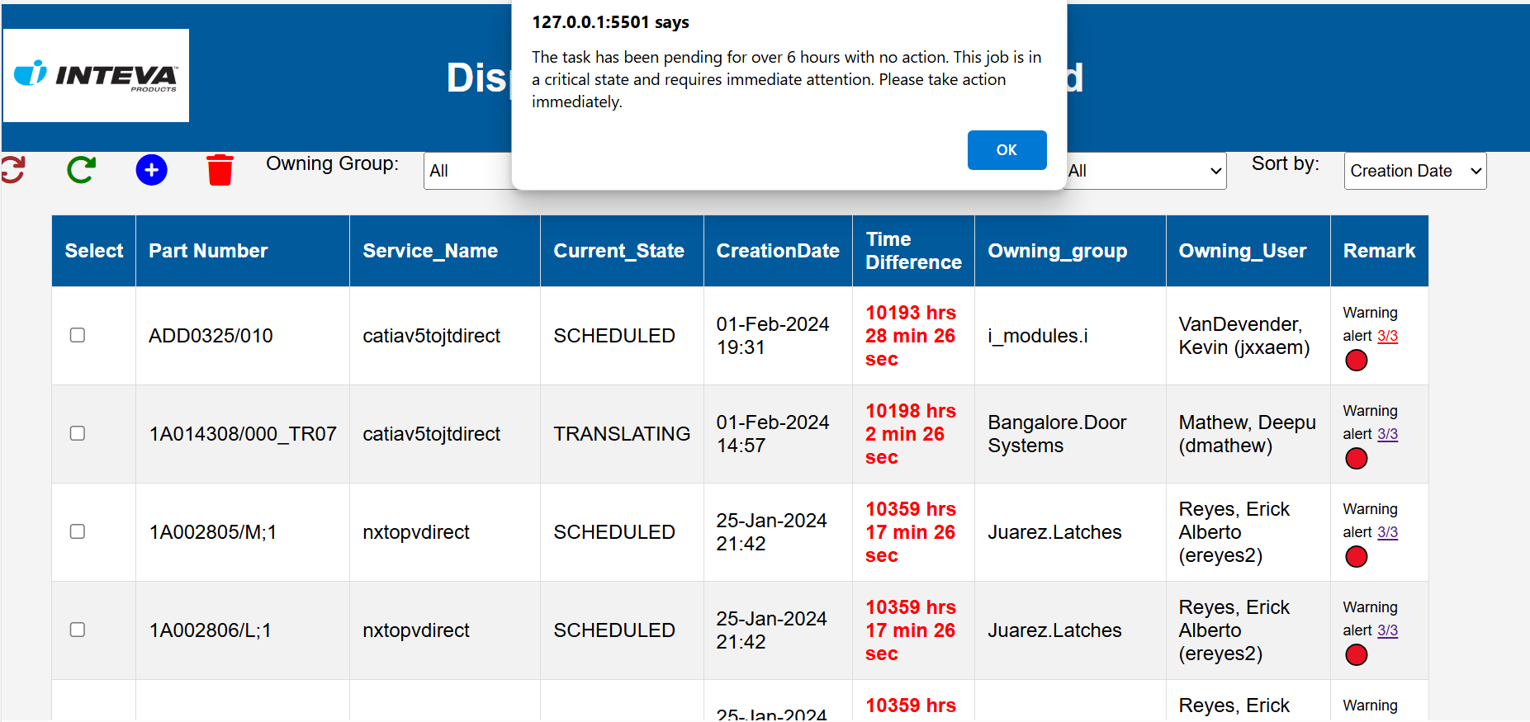
Screenshots

Slide 26
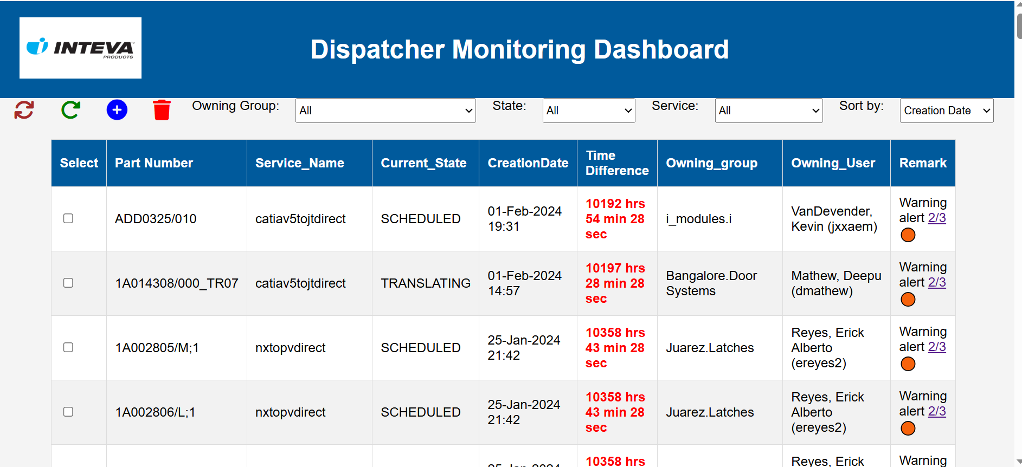
Screenshots

Slide 27
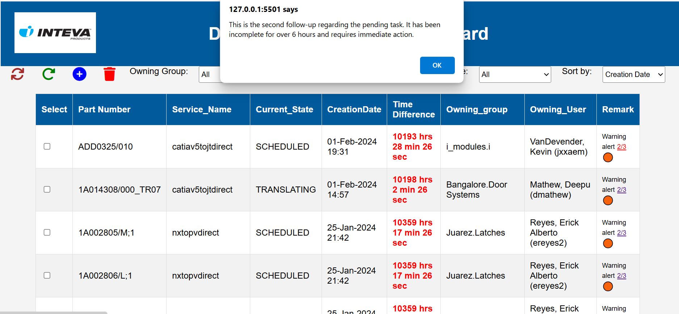
Screenshots

Slide 28
Github Link
Link: https://github.com/vathsalabs/Internship-Project.git

Slide 29
Thank you !!

